Slide 1
Smartphone Screen Orientation
Barrett Honors Thesis
Riley Tallman

Slide 2
Introduction My background
Graduating this semester 4+1
CSE 471 Intro to AI (Prof Gil)
CSE 494 AI In Cyber Security
CSE 494 Machine Learning
CSE 571 Artificial Intelligence
Nueral Networks, Random Forrests, CIFAR-10 CNN
Computer Vision
Self Driving Cars

Slide 3

Introduction The Problem

Slide 4
Solution 1 Pre-trained Models

Slide 5
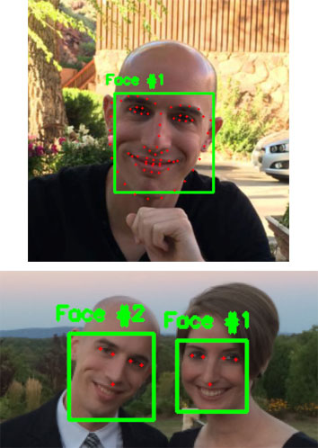
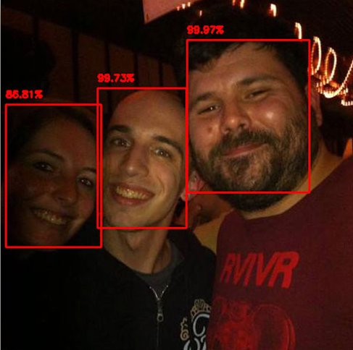

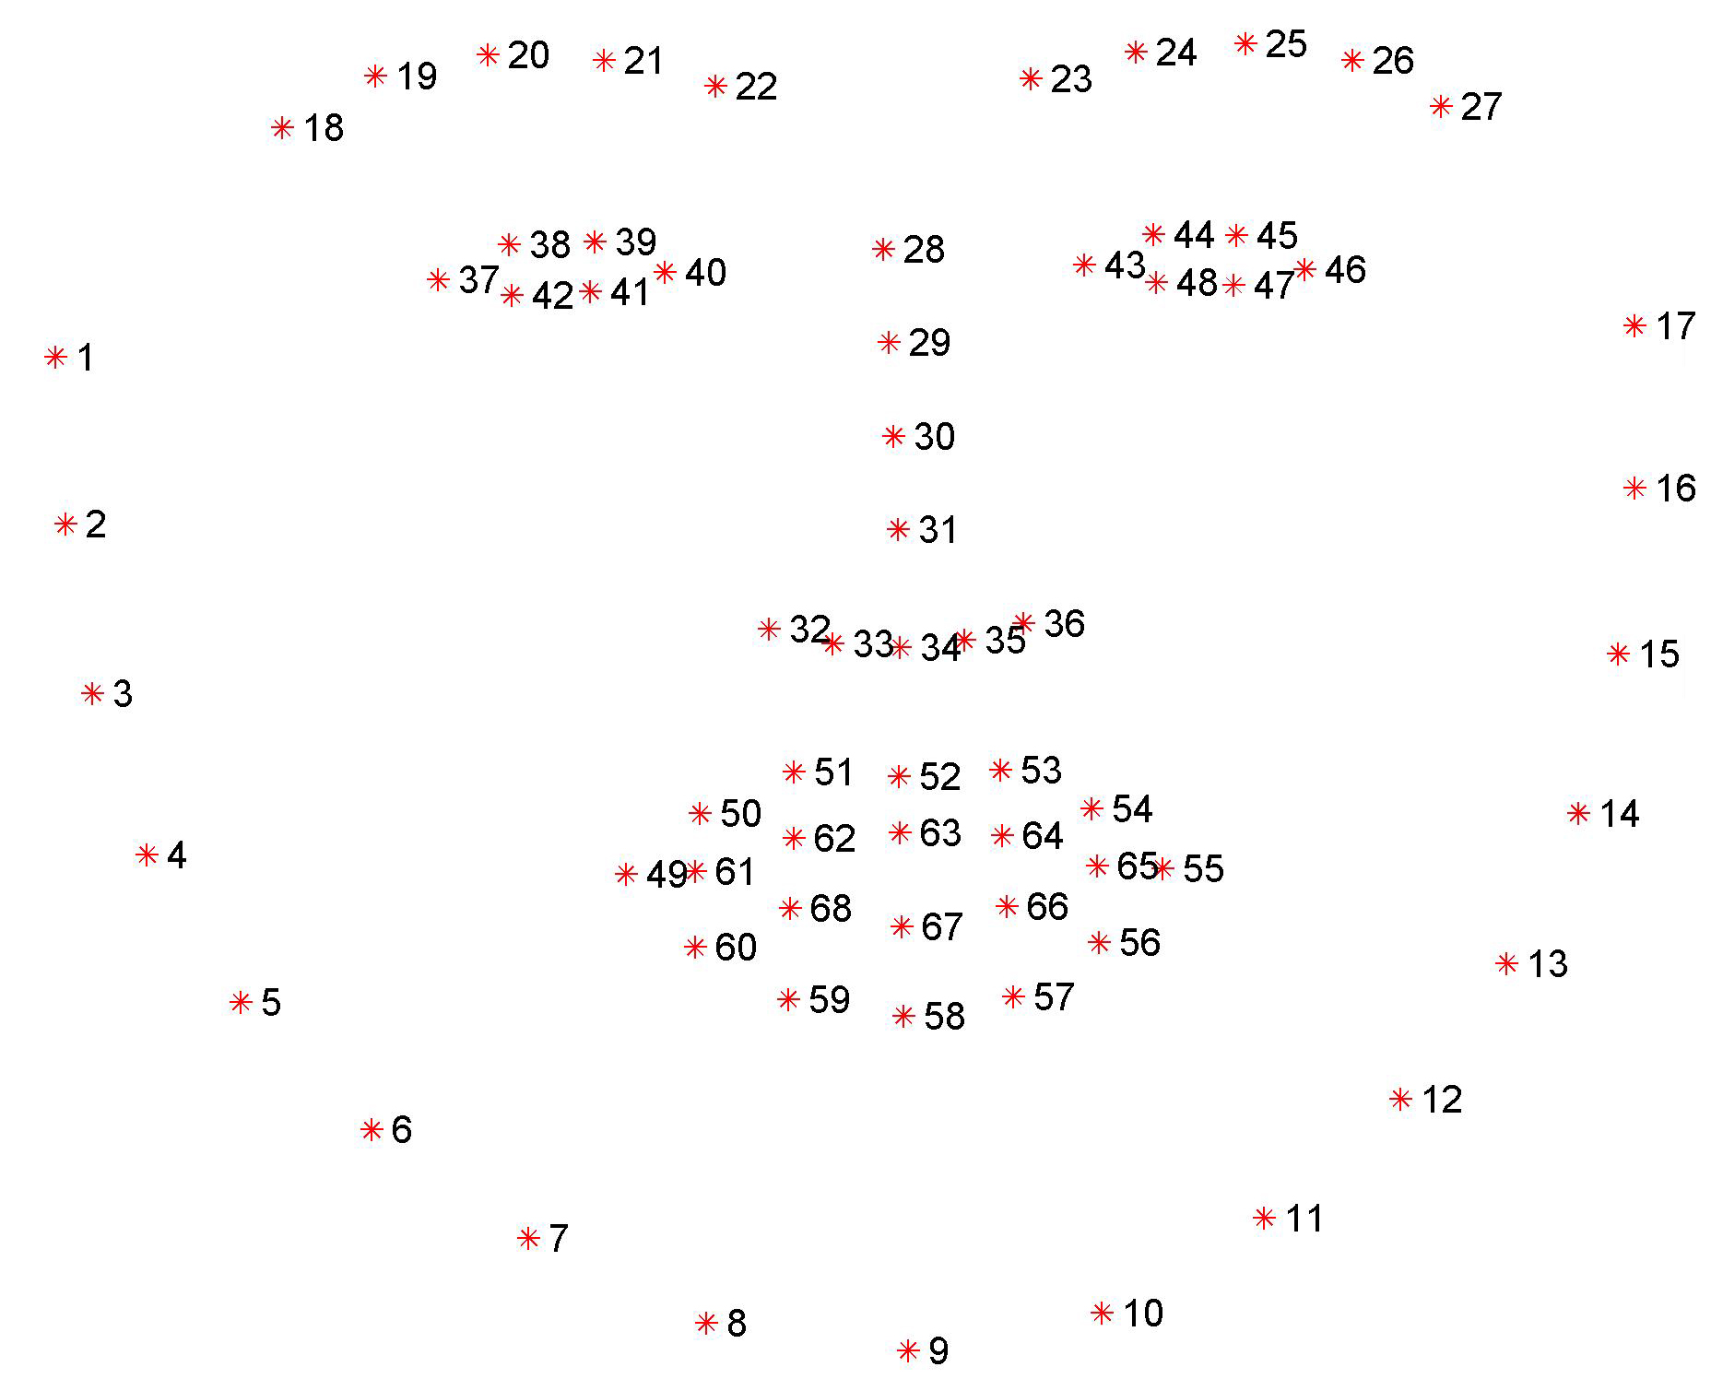
Solution 1 Pre-trained Models
dlib 68/5-point landmark detector
Orientation!
OpenCV/dlib
https://www.pyimagesearch.com/2017/05/22/face-alignment-with-opencv-and-python/

Slide 6
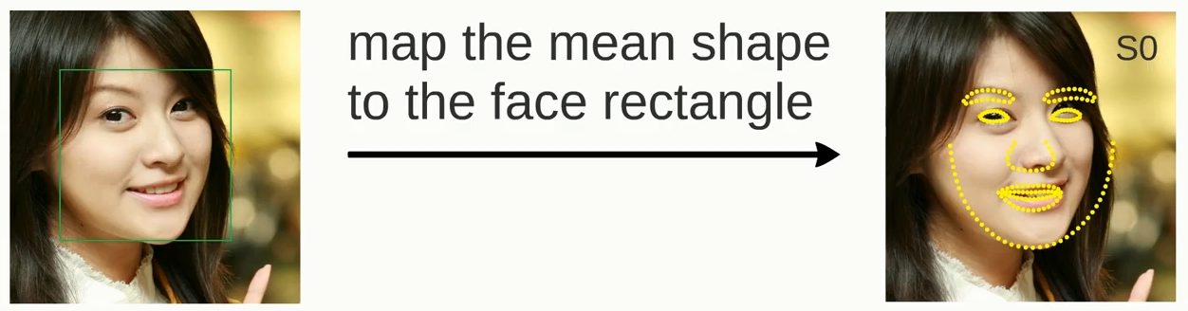
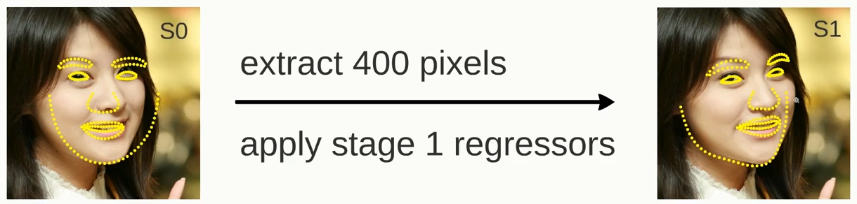
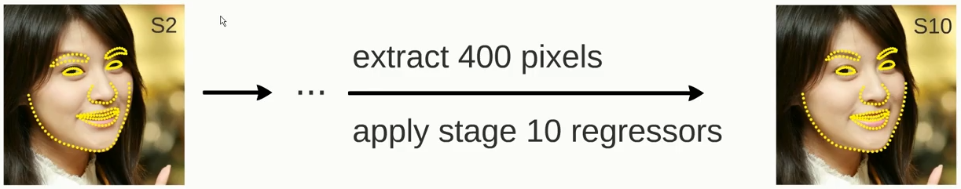
Solution 1 Pre-trained Models – Failure
https://www.youtube.com/watch?v=SLLZr9IjPcE

Slide 7
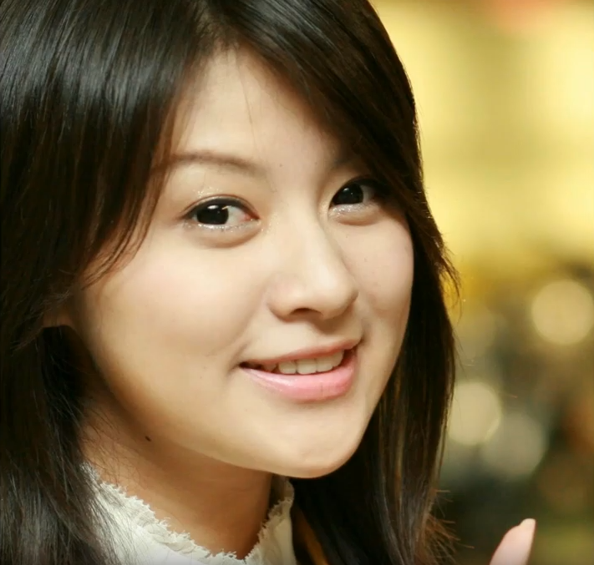
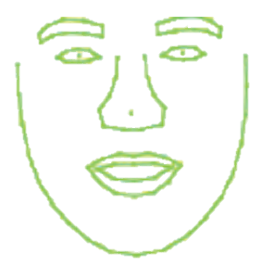
Solution 1 Pre-trained Models – Failure

Slide 8
Solution 2 Pre-trained Models – Failure
https://www.youtube.com/watch?v=SLLZr9IjPcE

Slide 9
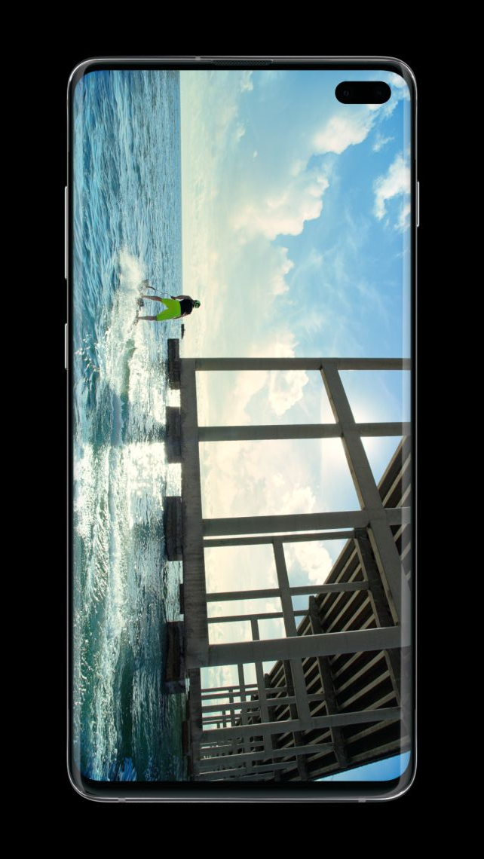
Introduction The Problem, a second application

